Slide 1

The Future of Fraud Detection at Shopkick
Daniel Ardila, Sriaansh Sahu, Sharvi Dadhich, Chuyang Yu

Slide 2
As Shopkick strives to catch and surpass Fetch and Ibotta in the competitive shopping rewards space, addressing fraud is critical.
Stemming fraud will reduce costs, enhance the user experience, increase the value of Shopkick to partner brands, and unlock greater opportunities to monetize user insights and leverage purchase behaviors for strategic growth.

Slide 3
Research
Existing fraud measures results in around $2 million loss a year
90% of monetary loss comes from promo code abuse and receipt falsification
Increasing fraud prevention measures diminishes user experience and alienates users
* Referrals and Promo Codes are not client funded

Slide 4
Recommendations
1. Modify Account Creation Process
2. Bracketed Payout Verification
3. Workflow Redesign Recommendations
4. Promo Code Fraud Prediction
5. Increased Limit for First Redemption

Slide 5
1. Market Research
2. Fraud Mapping and Impact Analysis
3. Tools and Systems Benchmarking
4. Recommendations
5. Evaluation and Next Steps

Slide 6
https://platform.tracxn.com/a/d/company/OAZESiWBzUQujLtEZouUwLm_UpLOr47wQjw1Asa3z8A/shopkick.com/marketshareretention

Slide 7


Offers on purchased items, Brand bonuses, Referrals
Walk-ins, Product scans, Purchases, Videos, Referrals, Promo Codes
Receipts (e and paper), Games, Offers, Referrals, Points boosts
11.9 million users in Q2 2024*
17 million monthly users as of 2022**
400,000 monthly users
~ 988 employees
50-75 employees
~ 734 employees
*https://www.investing.com/news/swot-analysis/ibottas-swot-analysis-digital-coupon-firms-stock-faces-growth-challenges-93CH-3755885
**https://business.fetch.com/newsroom/fetch-rewards-app-surpasses-5-million-daily-active-users

Slide 8
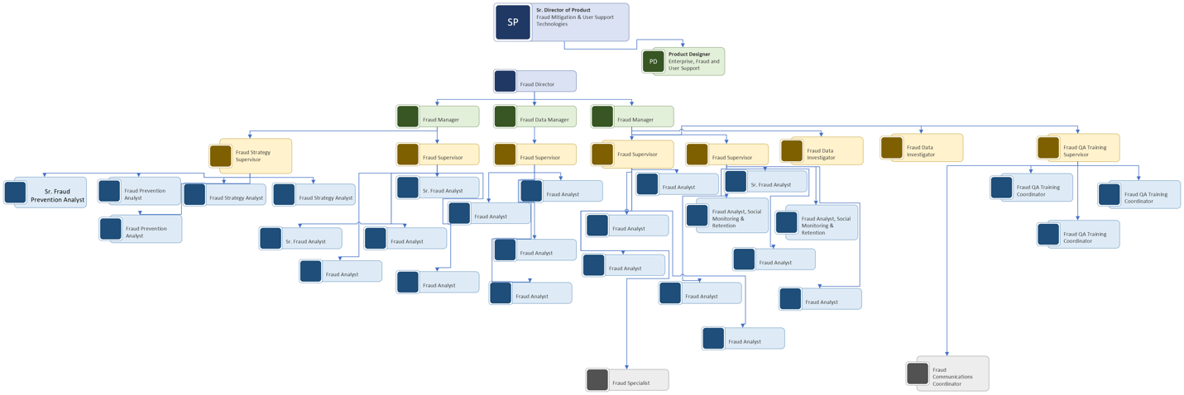
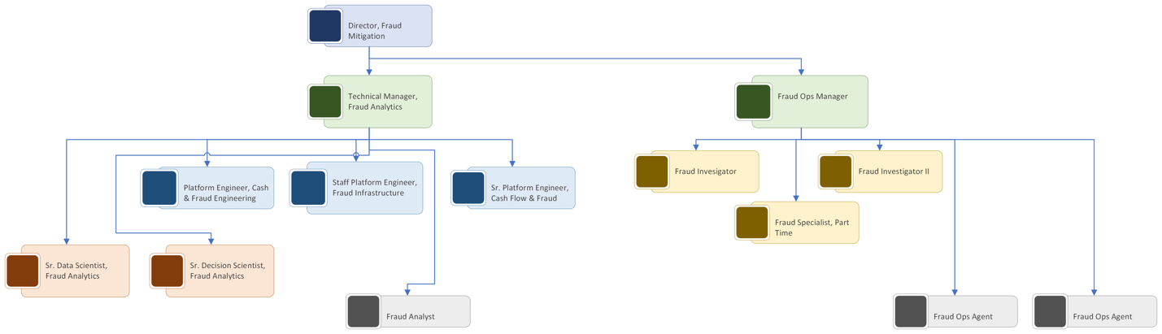
Fetch
Ibotta
44 employees
14 employees

Slide 9
1. Market Research
2. Fraud Mapping and Impact Analysis
3. Tools and Systems Benchmarking
4. Recommendations
5. Evaluation and Next Steps

Slide 10
Fraud Types
Account Creation
Kick Earning Actions
Redemption
Walk-in
Scanning
Receipt upload
Promo code
Referral code
Video viewing
Online purchase
Quiz
Phone number
Email
Rapid earn-to-redemption

Slide 11
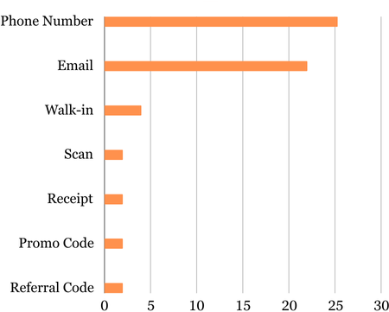
Frequency
Type | Fraud/100
Phone Number | 25
Email | 22
Walk-in | 4
Scanning | 2
Receipt Upload | 2
Promo Code | 2
Referral Code | 2

Slide 12
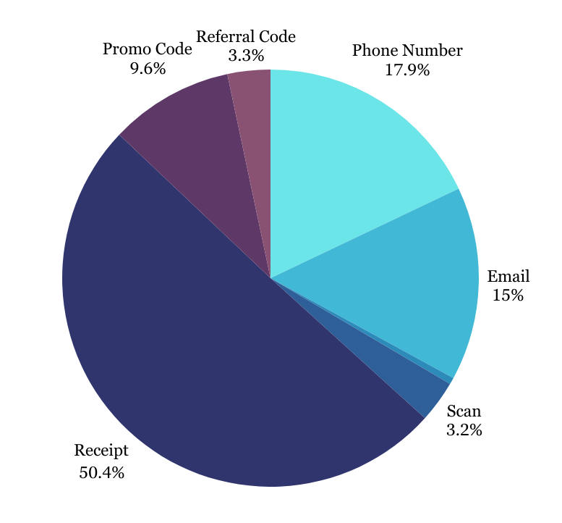
Impact
Types | Cost $
Phone Number | 627,720.97
Email | 525,089.79
Walk-in | 18,201
Scanning | 113,481
Receipt Upload | 1,761,931
Promo Code | 336,102
Referral Code | 116,451

Slide 13
Common Traits of Fraudsters
Phone number: frequently change
Email: randomly generated username, short age
Email: randomly generated username, short age
Walk-in: VPN/jailbroken, suspicious IP organizations
Walk-in: VPN/jailbroken, suspicious IP organizations
Scanning: VPN/jailbroken, short scanning intervals
Scanning: VPN/jailbroken, short scanning intervals
Receipt upload: Shopkick/high-kick items, multiple uploads
Receipt upload: Shopkick/high-kick items, multiple uploads
Promo code: exclusive promo code kick-earning behavior
Promo code: exclusive promo code kick-earning behavior
Referral code: new users with suspicious email
Referral code: new users with suspicious email

Slide 14
1. Market Research
2. Fraud Mapping and Impact Analysis
3. Tools and Systems Benchmarking
4. Recommendations
5. Evaluation and Next Steps

Slide 15




Slide 16
$ to redeem
$10 first time, $3, $5 available after
$2
$20
Phone verification at account creation
No
Yes
No
Bank Account
No
No
Yes

Slide 17
1. Market Research
2. Fraud Mapping and Impact Analysis
3. Tools and Systems Benchmarking
4. Recommendations
5. Evaluation and Next Steps

Slide 18
Email and Phone Number verification during account creation process

Slide 19
Account Age and 1st Transaction Age

Slide 20
Verify if the accounts are operated by Humans or not

Slide 21
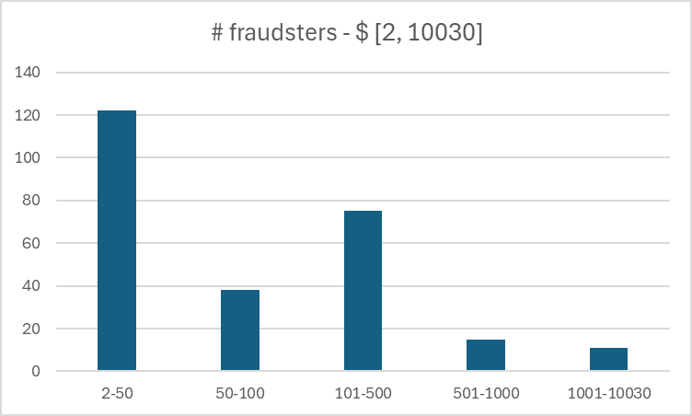
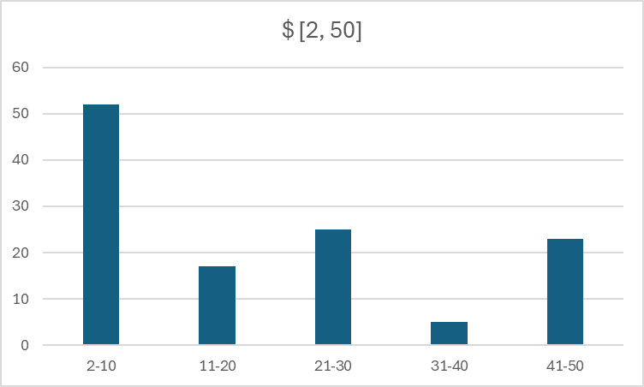
Bracket Payout Verification
*Based on Facebook survey and fraud report

Slide 22
Bracket Payout Verification
*Based on Facebook survey and fraud report
$2-25: basic verification-phone number
$50: dual verification-reverify the same phone number/email
$100: government ID
$500: dual verification-gov ID and reverify the same phone number

Slide 23
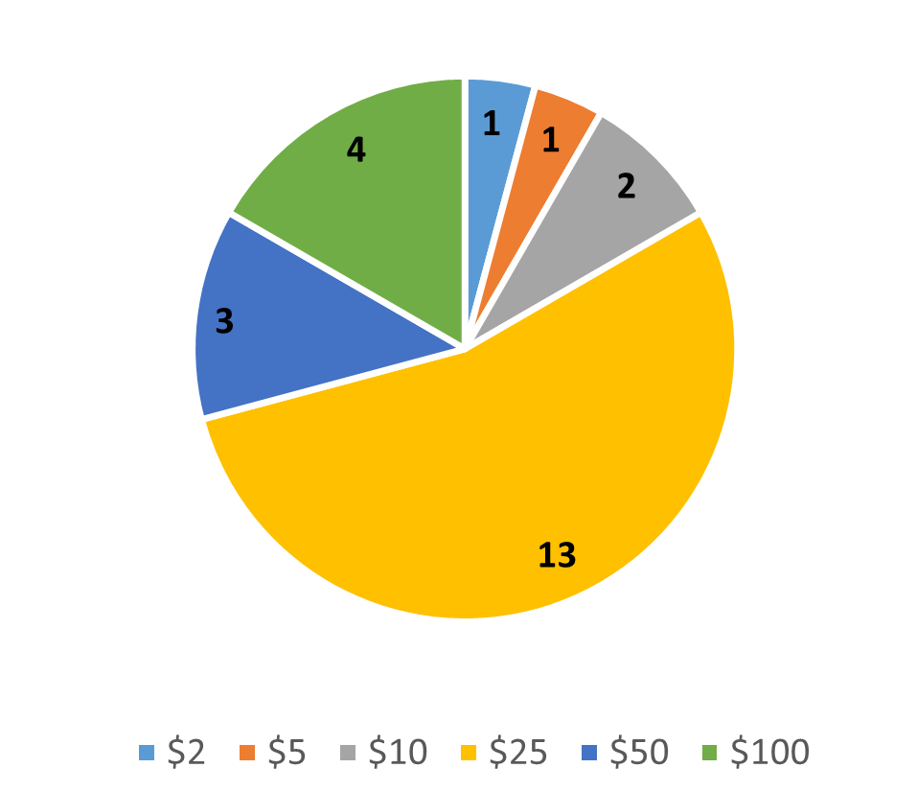
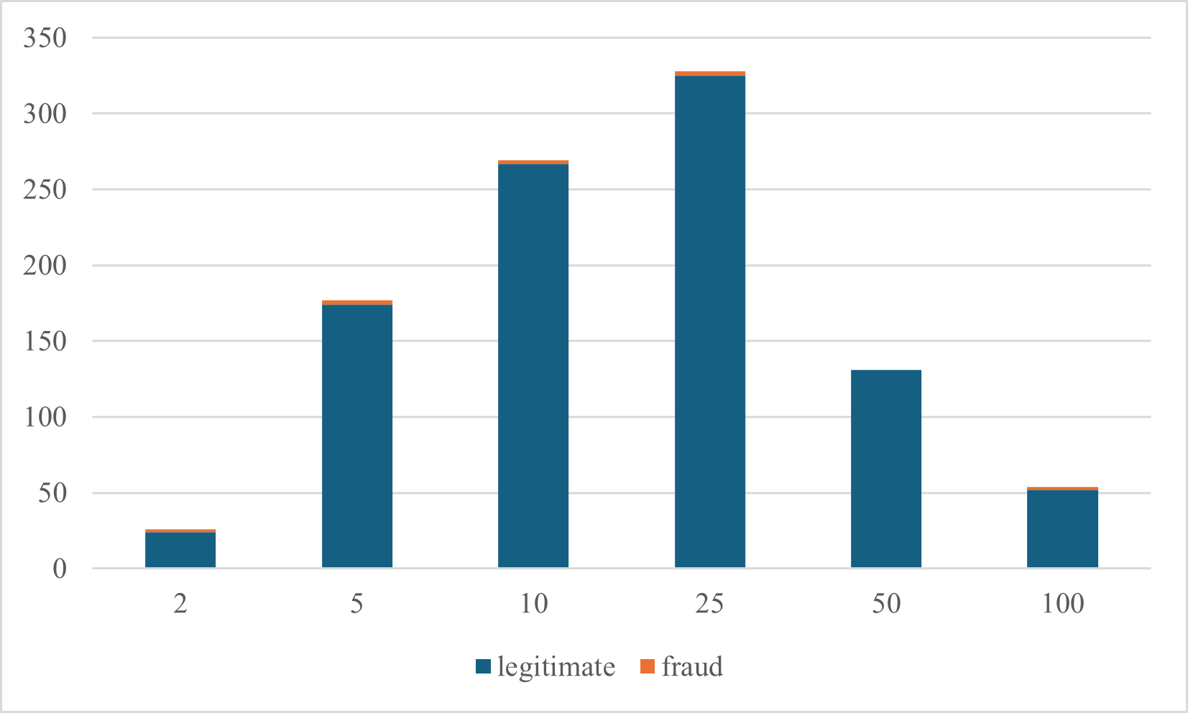
Increased Limit for First Redemption
Random 1000 users
Facebook Group
~10% Fraud

Slide 24
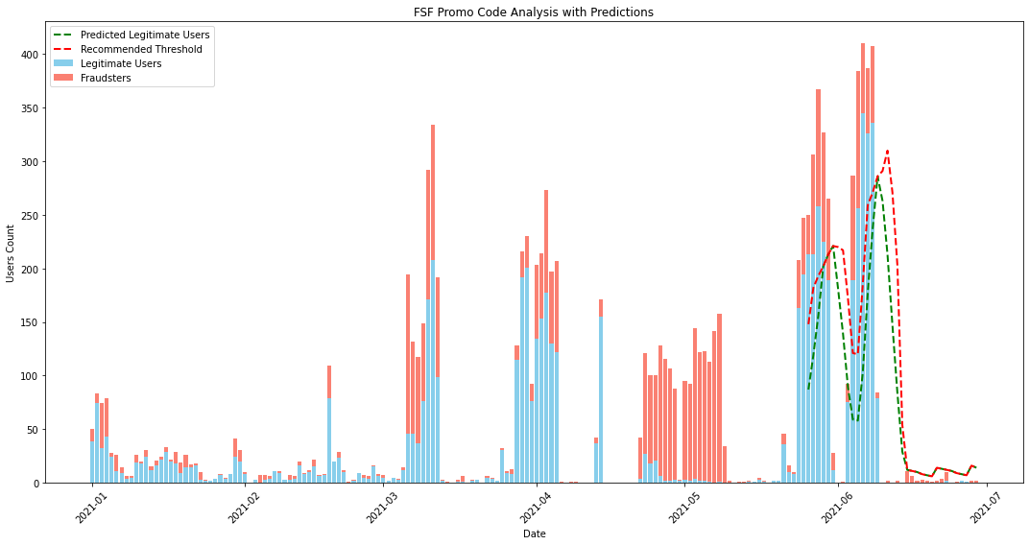
Training set
Test set

Slide 25
1. Market Research
2. Fraud Mapping and Impact Analysis
3. Tools and Systems Benchmarking
4. Recommendations
5. Evaluations and Next Steps

Slide 26
Evaluation
Account Creation Modification
75% reduction in the creation of fraudulent accounts
Bracket Payout Verification
Avoid $71,000 loss, while keeping 99% of legitimate users

Slide 27
Evaluation
Workflow Redesign
26% reduction in fraudulent users earning kicks
Promo Code Prediction
49% reduction in fraudulent promo code redemption when tested on FSF over 6 months
First Redemption Limit
For every $1,251 redeemed, $1 loss is prevented.

Slide 28
Prioritized Plan
1. Modify Account Creation Process
2. Workflow Redesign Recommendations
3. Bracketed Payout Verification
4. Promo Code Fraud Prediction
5. Increased Limit for First Redemption

Slide 30
Appendix

Slide 31
Company | Fraud Detection Tool | Key Features | User Feedback
Shopkick | Sift | - AI-driven fraud detection | Users highlight Sift’s accuracy in identifying fraud, though it may require some time for customization and setup.
 |  | - Real-time monitoring
 |  | - Customizable risk rules
Fetch | Kount (by Equifax) | - AI-powered real-time decision-making | Kount is praised for its advanced fraud detection capabilities, though integration challenges are noted by some users.
 |  | - Device fingerprinting
 |  | - Behavioral analytics
Ibotta | C.I.A & Imply | - Advanced analytics with Apache Druid | Users appreciate the scalability and performance of Imply, particularly for high-volume transaction monitoring.
 |  | - Real-time anomaly detection
 |  | - Scalable for large data sets
Upside | In-House Software | - Tailored to platform-specific needs | Feedback emphasizes flexibility but notes potential limitations in scaling and real-time capabilities.
 |  | - Combines manual and automated fraud detection
Rakuten | In-House Software | - Proprietary systems for fraud prevention | Rakuten’s system is well-suited for its business model, though details on specific capabilities are limited.
 |  | - Focus on online transaction monitoring

Slide 32
* Referrals and Promo Codes are not client funded

